Slide 1

Statistical Fundamentals:
Using Microsoft Excel for Univariate and Bivariate Analysis
Alfred P. Rovai
Dependent t-Test
PowerPoint Prepared by
Alfred P. Rovai
Microsoft® Excel® Screen Prints Courtesy of Microsoft Corporation.

Slide 2
Dependent t-Test
The Dependent t-Test, also known as Paired-Samples t-Test and Dependent Samples t-Test, is a parametric procedure that analyzes mean difference scores obtained from two dependent (related) samples.
Each case in one sample has a unique corresponding member in the other sample. `
  Natural pairs: compare pairs that occur naturally, e.g., twins.
  Matched pairs: compare matched pairs, e.g., husbands and wives.
  Repeated measures: compare two observations, e.g., pretest and posttest.
Excel data entry for the Dependent t-Test is accomplished by entering each observation, e.g., pretest and posttest, as separate columns in an Excel spreadsheet.

Slide 3
Dependent t-Test
One can compute the t-value using the following formula:
where the numerator is the difference in means of group 1 and group 2 and the denominator is the estimated standard error of the difference divided by the square root of the number of paired observations.

Slide 4
Dependent t-Test
Cohen’s d measures effect size and is often used to report effect size following a significant t-test. The formula for Cohen’s d for the Dependent t-Test is:
By convention, Cohen’s d values are interpreted as follows:
  Small effect size = .20
  Medium effect size = .50
  Large effect size = .80

Slide 5
Key Assumptions & Requirements
Random selection of samples to allow for generalization of results to a target population.
Variables. IV: a dichotomous categorical variable, e.g., observation. DV: an interval or ratio scale variable. The data are dependent.
Normality. The sampling distribution of the differences between paired scores is normally distributed. (The two related groups themselves do not need to be normally distributed.)
Sample size. The Dependent t-Test is robust to mild to moderate violations of normality assuming a sufficiently large sample size, e.g., N > 30. However, it may not be the most powerful test available for a given non-normal distribution.

Slide 6
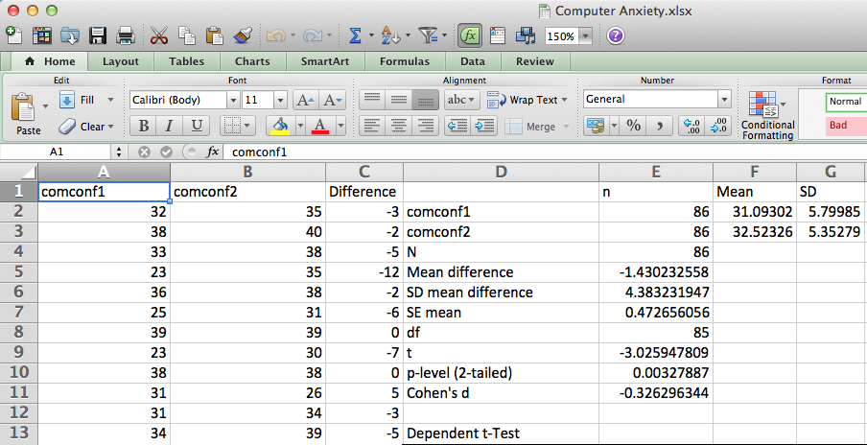
Open the dataset Computer Anxiety.xlsx. Click on the Dependent t-Test worksheet tab.
File available at http://www.watertreepress.com/stats
TASK
Respond to the following research question and null hypothesis:
Is there a difference between computer confidence pretest and computer confidence posttest among university students, μ1 − μ2 ≠ 0?
H₀: There is no difference between computer confidence pretest and computer confidence posttest among university students, μ1 − μ2 = 0.

Slide 7
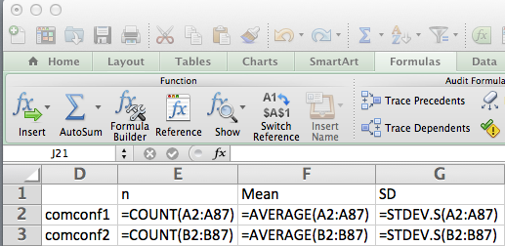
Enter the labels and formulas shown in cells D1:G3 in order to generate descriptive statistics.

Slide 8
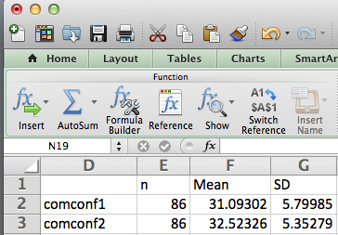
Results show that the mean computer confidence posttest (comconf2) score is higher than the mean computer confidence pretest (comconf1) score. Dependent t-Test results will show whether or not this arithmetic difference is statistically significant.

Slide 9
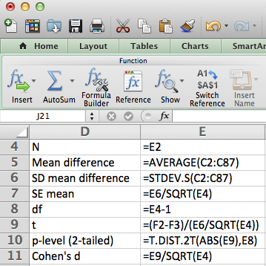
Enter the formulas shown in cells D4:E11 in order to generate Dependent t-Test results. Note: Cells C2:C87 contain the differences between pretest and posttest scores.

Slide 10
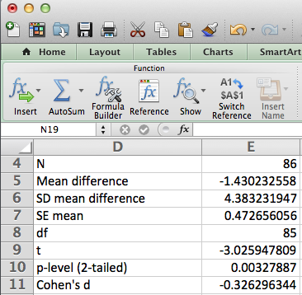
Test results provide evidence that the difference between computer confidence pretest (M = 31.09, SD = 5.80) and computer confidence posttest (M =32.52, SD = 535) was statistically significant, t(85) = 3.03, p = .003 (2-tailed), d = .33.

Slide 11
Dependent t-Test
End of Presentation

